Slide 1
Introduction to SQL
Emily Nomura

Slide 2
Learning Outcomes
What is SQL?
Selecting columns
Relevance
Filtering Rows

Slide 3
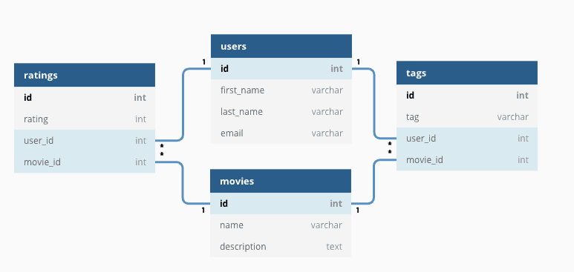
What is SQL?
Notes:
Database management system
Simpler terms: Platform to access tables that are related
Relevance in DS: Send, retrieve, and organize information with queries

Slide 4
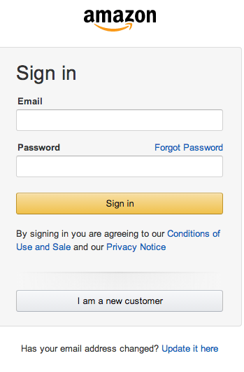
SQL “in the wild”
Customer data:
Logins
Personal info (billing address, payment type, etc.)
Past purchases
Browsing history
Support requests
Notes:
“The power of SQL” - draw specific information from all of these different tables in order to better:
Target an ad
Recommend an item to you

Slide 5
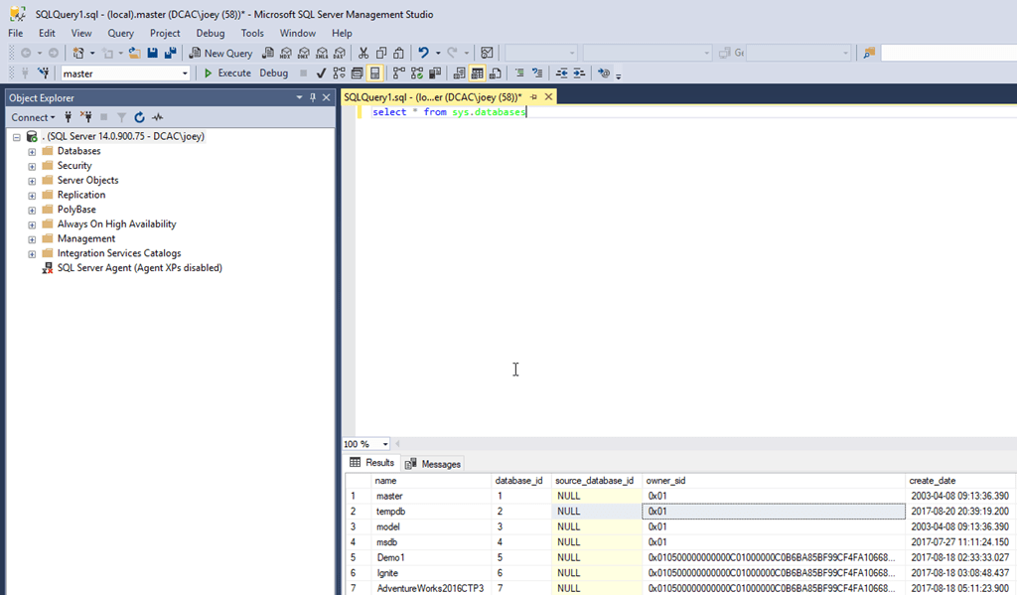
User Interface

Slide 6
SELECT Statements
SELECT name, unemployment
FROM countries
SELECT *
FROM countries
 | name | unemployment
1 | Canada | 6.30
2 | Canada | 5.79
3 | Chile | 6.70
4 | Colombia | 9.30
countries
 | name | population | area | unemployment
1 | Canada | 37,694,085 | 9,984,670 | 6.30
2 | Canada | 37,487,816 | null | 5.79
3 | Chile | 18,186,770 | 756,102 | 6.70
4 | Colombia | 49,084,841 | 1,138,910 | 9.30
CIA Factbook, Guide to Country Comparisons
Notes:
Key SQL syntax will be in CAPS → better organization

Slide 7
Other Useful Operations
Filtering rows
Example: Only interested in customer ID 123
Aggregate functions
Sum, count, avg, min, max, etc.
Notes:
Add complexity to queries to better tailor our output

Slide 8
SELECT Statements with DISTINCT and COUNT
SELECT DISTINCT name
FROM countries
SELECT DISTINCT area
FROM countries
SELECT COUNT(*)
FROM countries
 | name
1 | Canada
2 | Chile
3 | Colombia
 | area
1 | null
2 | 9,984,670
3 | 756,102
4 | 1,138,910
 | count
1 | 4
SELECT COUNT(area)
FROM countries
 | count
1 | 3
Notes:
DISTINCT returns null values
COUNT returns the number of non-missing entries

Slide 9
SELECT Statements with DISTINCT
SELECT DISTINCT name
FROM countries
SELECT DISTINCT area
FROM countries
 | name
1 | Canada
2 | Chile
3 | Colombia
 | area
1 | null
2 | 9,984,670
3 | 756,102
4 | 1,138,910
Notes:
DISTINCT returns null values

Slide 10
Combining DISTINCT and COUNT
countries
 | name | population | area | unemployment
1 | Canada | 37,694,085 | 9,984,670 | 6.30
2 | Chile | 18,186,770 | 756,102 | 6.70
3 | Colombia | 49,084,841 | 1,138,910 | 9.30
4 | Canada | 37,487,816 | null | 5.79
SELECT COUNT(DISTINCT area)
FROM countries
Quiz Q!
Notes:
COUNT is the “wrapper” (outer) function. This command returns 3.

Slide 11
Filtering Rows
SELECT COUNT(*)
FROM countries
WHERE unemployment < 7
AND area > 1,000,000
= equal
<> not equal
< less than
> greater than
<= less than or equal to
>= greater than or equal to
IS NULL
IS NOT NULL
SELECT name, population
FROM countries
WHERE name = ‘Canada’
 | count
1 | 1
 | name | population
1 | Canada | 37,694,085
2 | Canada | 37,487,816
SELECT name, area
FROM countries
WHERE area IS NULL
 | name | area
1 | Canada | null
Notes:
WHERE comes after the FROM statement
A variable that is an integer does not need ‘ticks’ around it, only strings
You can use as many AND and OR statements as you like
IS NULL is useful to find missing data and IS NOT NULL filters out missing data

Slide 12
Filtering Rows
SELECT name, population
FROM countries
WHERE name = ‘Canada’
SELECT name, area
FROM countries
WHERE area IS NULL
= equal
<> not equal
< less than
> greater than
<= less than or equal to
>= greater than or equal to
IS NULL
IS NOT NULL
 | name | population
1 | Canada | 37,694,085
2 | Canada | 37,487,816
 | name | area
1 | Canada | null
Notes:
WHERE comes after the FROM statement
A variable that is an integer does not need ‘ticks’ around it, only strings
You can use as many AND and OR statements as you like
IS NULL is useful to find missing data and IS NOT NULL filters out missing data

Slide 13
Filtering Rows with BETWEEN and IN
SELECT name, area
FROM countries
WHERE area BETWEEN 1e+6 AND 1e+7
SELECT name, unemployment
FROM countries
WHERE unemployment IN (6.3, 6.7, 9.3)
 | name | area
1 | Canada | 9,984,670
2 | Colombia | 1,138,910
 | name | unemployment
1 | Canada | 6.30
2 | Chile | 6.70
3 | Columbia | 9.30
Notes:
BETWEEN provides a shorthand for filtering values within a specified range
WHERE IN is used to filter for multiple specific values rather than writing many OR conditions

Slide 14
Filtering Rows with LIKE and NOT LIKE
Wildcards:
‘%’
Placeholder for one or many integers or characters
‘_’
Placeholder for a single character
SELECT name
FROM countries
WHERE name LIKE ‘Ca%’
SELECT name
FROM countries
WHERE name NOT LIKE ‘Ca%’
 | name
1 | Canada
2 | Canada
 | name
1 | Chile
2 | Colombia
Notes:
How to search for a pattern in text rather than a specific word?

Slide 15
Additional Resources
DataCamp
W3Schools
Notes:
Thank you for listening!

